Slide 1
Component Diagram

Slide 2
INTRODUCTION
UML component diagrams describe software components and their dependencies to each others
A component is an autonomous unit within a system
The components can be used to define software systems of arbitrary size and complexity
UML component diagrams enable to model the high-level software components, and the interfaces to those components
Important for component-based development (CBD)
Component and subsystems can be flexibly REUSED and REPLACED
A dependency exists between two elements if changes to the definition of one element may cause changes to the other
Component Diagrams are often referred to as “wiring diagrams”
The wiring of components can be represented on diagrams by means of components and dependencies between them

Slide 3
INTRODUCTION
An UML diagram classification:
Static
Use case diagram, Class diagram
Dynamic
State diagram, Activity diagram, Sequence diagram, Collaboration diagram
Implementation
Component diagram, Deployment diagram
UML components diagrams are implementation diagrams which describe the different elements required for implementing a system

Slide 4
INTRODUCTION
Another classification:
Behavior diagrams
A type of diagram that depicts behavior of a system
This includes activity, state machine, and use case diagrams, interaction diagrams
Interaction diagrams
A subset of behavior diagrams which emphasize object interactions. This includes collaboration, activity, sequence diagrams
Structure diagrams
A type of diagram that depicts the elements of a specification that are irrespective of time. This includes class, composite structure, component, deployment
UML components diagrams are structure diagrams

Slide 5
COMPONENT in UML 2.0
Modular unit with well-defined interfaces that is replaceable within its environment
Autonomous unit within a system
Has one or more provided and required interfaces
Its internals are hidden and inaccessible
A component is encapsulated
Its dependencies are designed such that it can be treated as independently as possible

Slide 6
Component Diagram
A component is an encapsulated, reusable, and replaceable part of your software
Reducing and defying coupling between software components
Reusing existing components
The ability to identify software components (which are encapsulated, reusable and replaceable) supports development strategies that use, e.g., COTS (Commercial- Off-The-Shelf) components.

Slide 7
Component Diagram
A Component is a self-contained unit that encapsulates the state and behavior of a number of Classifiers.
In UML, a Classifier represents a classification of instances according to their Features.
For instance: a category of entities in the domain
A classifier has attributes

Slide 8
Component Diagram
Model physical software components and the interfaces between them
Show the structure of the code itself
Can be used to hide the specification detail (i.e., information hiding) and focus on the relationship between components
Model the structure of software releases; show how components integrate with current system design
Model source code and relationships between files
Specify the files that are compiled into an executable

Slide 9
Component diagram
Component Diagrams can show how subsystems relate and which interfaces are implemented by which component.
A Component Diagram shows one or more interfaces and their relationships to other components.
A Component Diagram shows the dependencies among software components, including source code, binary code and executable components.
Some components exist at compile time, some exist at link time, and some exist at run time; some exist at more that one time.

Slide 10
Component Modelling
Find components and dependencies
Identify and level subcomponents
Clarify and make explicit the interfaces between components

Slide 11
When to use component diagrams
Use component diagrams when you are dividing your system into components and want to show their interrelationships through interfaces or the breakdown of components into a lower-level structure.

Slide 12
How to produce component diagrams
Decide on the purpose of the diagram
Add components to the diagram, grouping them within other components if appropriate
Add other elements to the diagram, such as classes, objects and interfaces
Add the dependencies between the elements of the diagram

Slide 13
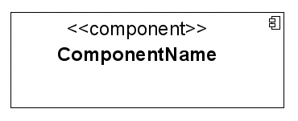
Component notation
A Component is a physical piece of a system, such as a compiled object file, piece of source code, shared library or Enterprise Java Bean (EJB).
Note that UML 2.0 uses a new notation for a component. Previous UML versions use the component icon as the main shape.

Slide 14


COMPONENT NOTATION
A component is shown as a rectangle with
A keyword <<component>>
Optionally, in the right hand corner a component icon can be displayed
A component icon is a rectangle with two smaller rectangles jutting out from the left-hand side
This symbol is a visual stereotype
The component name
Components can be labelled with a stereotype. There are a number of standard stereotypes. ex:<<entity>>,<<subsystem>>

Slide 15
Component ELEMENTS
A component can have
Interfaces
An interface represents a declaration of a set of operations and obligations
Usage dependencies
A usage dependency is a relationship where one element requires another element for its full implementation
Ports
Port represents an interaction point between a component and its environment
Connectors
Connect two components
Connect the external contract of a component to the internal structure

Slide 16
INTERFACE
A component defines its behaviour in terms of provided and required interfaces
An interface
Is the definition of a collection of one or more operations
Provides only the operations but not the implementation
Implementation is normally provided by a class/ component
In complex systems, the physical implementation is provided by a group of classes rather than a single class

Slide 17
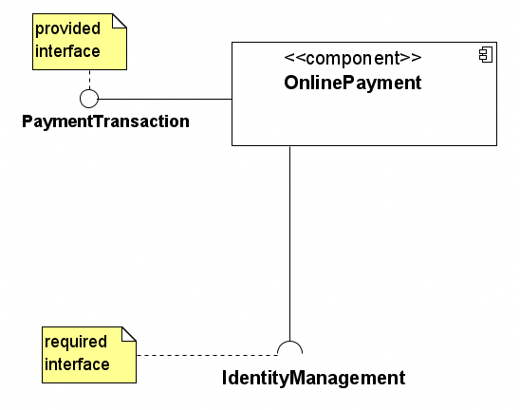
Component interfaces

Slide 18
Component interfaces
A provided interface of a component is an interface that the component realizes
A required interface of a component is an interface that the component needs to function
The provided and required Interfaces of a Component may be shown by means of ball (lollipop) and socket notation, respectively.

Slide 19
Component interfaces
Class interfaces have similar notations (definitions).
Provided interfaces define “a set of public attributes and operations that must be provided by the classes that implement a given interface”.
Required interfaces define “a set of public attributes and operations that are required by the classes that depend upon a given interface”.
Java Warnings: Note that these definitions of interfaces differ from the Java definition of interfaces. The Java definition of interfaces does not allow to have attributes, nor hence state.

Slide 20
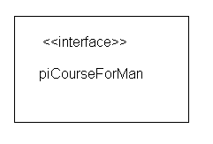
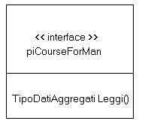
INTERFACE
May be shown using a rectangle symbol with a keyword <<interface>> preceding the name
For displaying the full signature, the interface rectangle can be expanded to show details
Can be
Provided
Required

Slide 21


INTERFACE
A provided interface
Characterize services that the component offers to its environment
Is modeled using a ball, labelled with the name, attached by a solid line to the component
A required interface
Characterize services that the component expects from its environment
Is modeled using a socket, labelled with the name, attached by a solid line to the component
In UML 1.x were modeled using a dashed arrow

Slide 22


INTERFACE
Where two components/classes provide and require the same interface, these two notations may be combined
The ball-and-socket notation hint at that interface in question serves to mediate interactions between the two components
If an interface is shown using the rectangle symbol, we can use an alternative notation, using dependency arrows

Slide 23
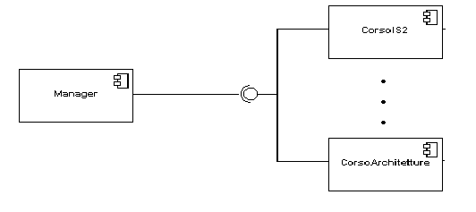
INTERFACE
In a system context where there are multiple components that require or provide a particular interface, a notation abstraction can be used that combines by joining
the interfaces

Slide 24
dependencies
Reside Dependencies: A reside dependency from a component to any UML element indicates that the component is a client of the element, which is considered itself a supplier, and that the element resides in the component.
Use Dependencies: A use dependency from a client component to a supplier component indicates that the client component uses or depends on the supplier component. A use dependency from a client component to a supplier components interface indicates that the client component uses or depends on the interface provided by the supplier component.
Deploy Dependency: A deploy component from a client component to a supplier node indicates that the client components is deployed on the supplier node.

Slide 25

DEPENDENCIES
Components can be connected by usage dependencies
Usage Dependency
A usage dependency is relationship which one element requires another element for its full implementation
Is a dependency in which the client requires the presence of the supplier
Is shown as dashed arrow with a <<use>> keyword

Slide 26
Dependencies among components

Slide 27
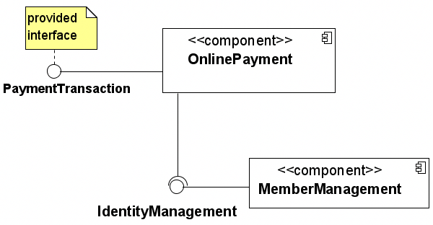
Component Assemblies
Components can be “wired” together to form subsystems

Slide 28
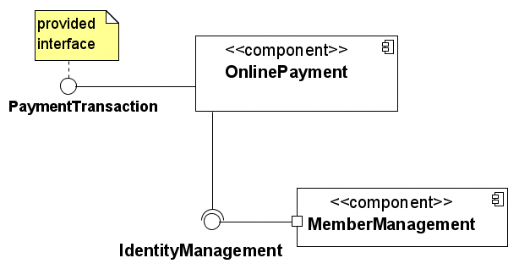
ports
A port (definition) indicates that the component itself does not provide the required interfaces
(e.g., required or provided). Instead, the component delegates the interface(s) to an internal class.

Slide 29
ports
Component Realization: A component might implement (realize) the provided interfaces for the component, or it may delegate that realization to other classes that make up that component. The realization dependency can be shown in three ways:
listing the realization classes
using realization dependency relationships
showing containment graphically.
Ports Forwarding and Filtering: Ports connect to the required and provided interfaces on the outside of the class. They can also connect to the classes of the component itself.

Slide 30
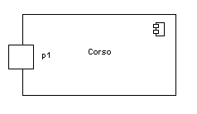
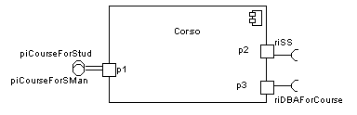
PORT
Specifies a distinct interaction point
Between that component and its environment
Between that component and its internal parts
Is shown as a small square symbol
Ports can be named, and the name is placed near the square symbol
Is associated with the interfaces that specify the nature of the interactions that may occur over a port

Slide 31

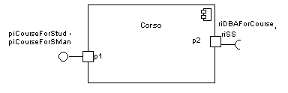
PORT
Ports can support unidirectional communication or bi-directional communication
If there are multiple interfaces associated with a port, these interfaces may be listed with the interface icon, separated by a commas

Slide 32
PORT
All interactions of a component with its environment are achieved through a port
The internals are fully isolated from the environment
This allows such a component to be used in any context that satisfies the constraints specified by its ports
Ports are not defined in UML 1.x

Slide 33

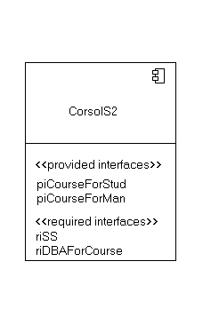
EXTERNAL VIEW
A component has an external view and an internal view
An external view (or black box view) shows publicly visible properties and operations
An external view of a component is by means of interface symbols sticking out of the component box
The interface can be listed in the compartment of a component box

Slide 34
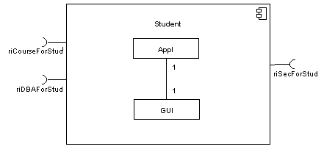
INTERNAL VIEW
An internal, or white box view of a component is where the realizing classes/components are nested within the component shape
Realization is a relationship between two set of model elements
One represents a specification
The other represent an implementation of the latter

Slide 35
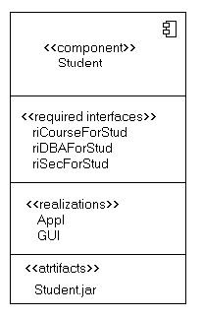
INTERNAL VIEW
The internal class that realize the behavior of a component may be displayed in an additional compartment
Compartments can also be used to display parts, connectors or implementation artifacts
An artifact is the specification of a phisycal piece of information

Slide 36
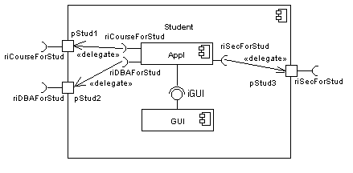
INTERNAL VIEW
Components can be built recursively

Slide 37

ASSEMBLY
Two kinds of connectors:
Delegation
Assembly
ASSEMBLY CONNECTOR
A connector between 2 components defines that one component provides the services that another component requires
It must only be defined from a required interface to a provided interface
An assembly connector is notated by a “ball-and-socket” connection
This notation allows for succint grafical
wiring of components

Slide 38
SEMANTICS for an assembly connector
The semantics for an assembly connector:
Are that signals travel along an instance of a connector originating in a required port and delivered to a provided port
The interfaces provided and required must be compatible
The interface compatibility between provided and required ports that are connected enables an existing component in a system to be replaced

Slide 39
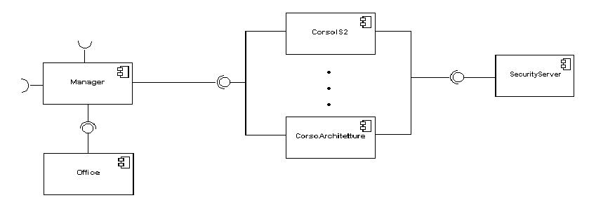
SEMANTICS for an assembly connector
Multiple connections directed from a single required interface to provided interfaces indicates that the instance that will handle the signal will be determined at execution time

Slide 40
DELEGATION CONNECTOR
DELEGATION CONNECTOR
Links the external contract of a component to the internal realization
Represents the forwarding of signals
It can only be defined between used interfaces or ports of the same kind

Slide 41
DELEGATION
The target interface must support a signature compatible with a subset of operations of the source interface
A port may delegate to a set of ports on subordinate components
The union of the target interfaces must be signature compatible with the source interface
Semantics:
Is a declaration that behaviour that is available on a component instance is not realized by that component itself, but by another instance that has compatible capabilities
Is used to model the hierarchical decomposition
Message and signal flow will occur between the connected ports

Slide 42
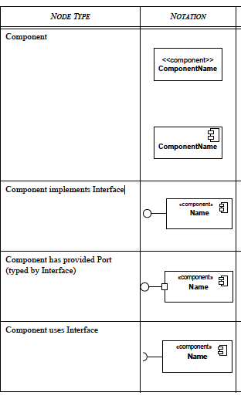
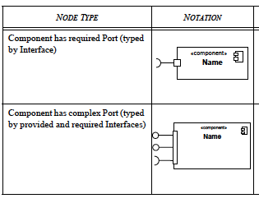
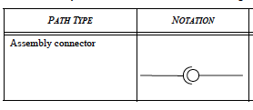

Slide 43
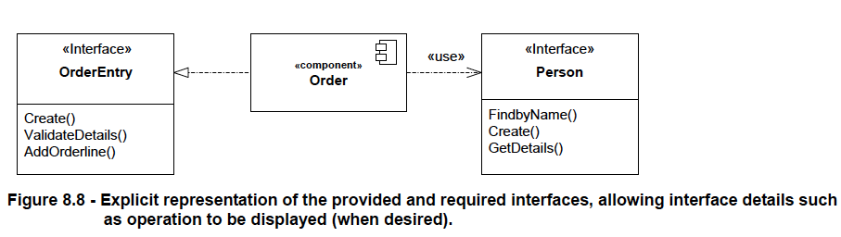

Slide 44
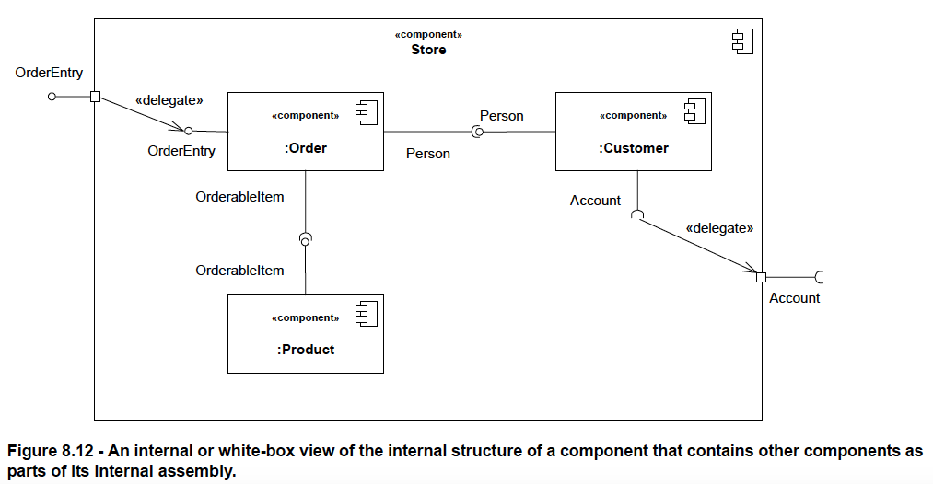

Slide 45
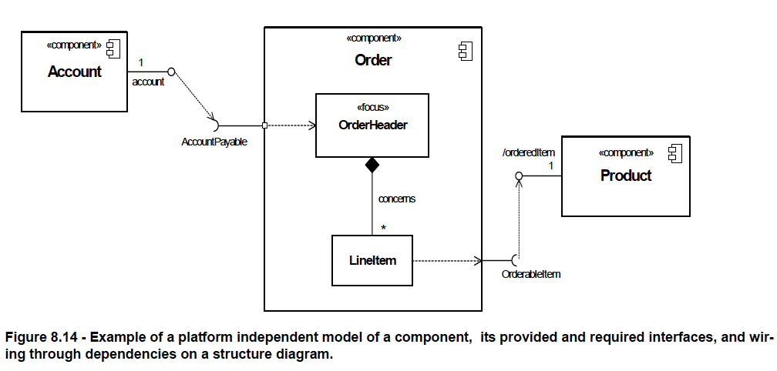

Slide 46
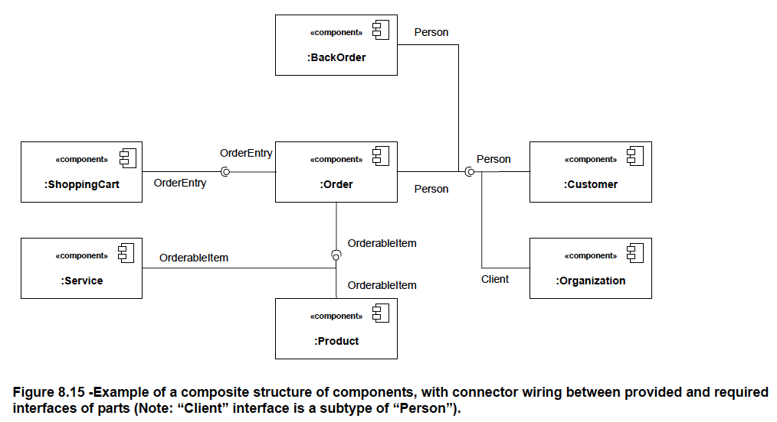

Slide 47
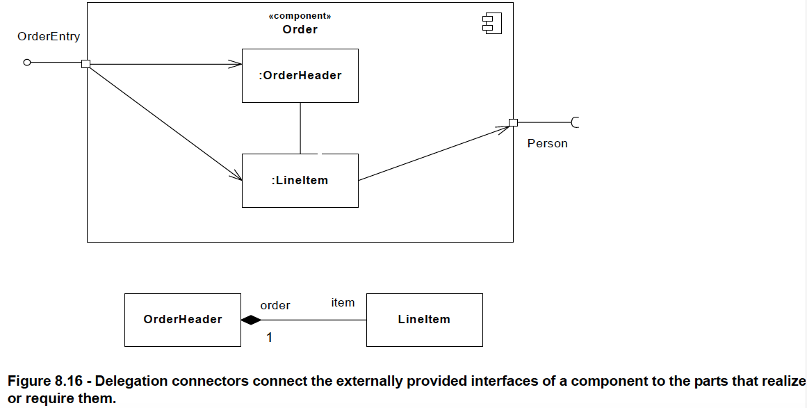

Slide 48
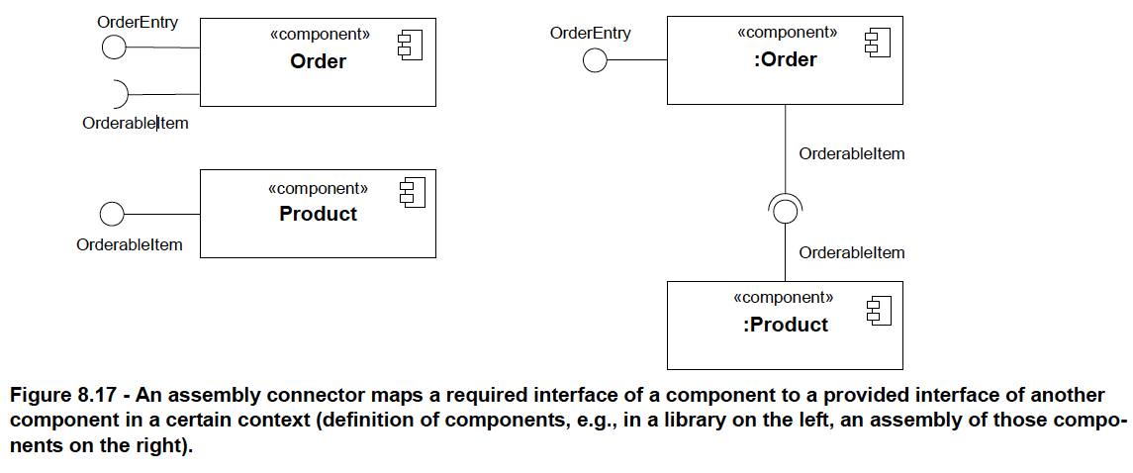

Slide 49
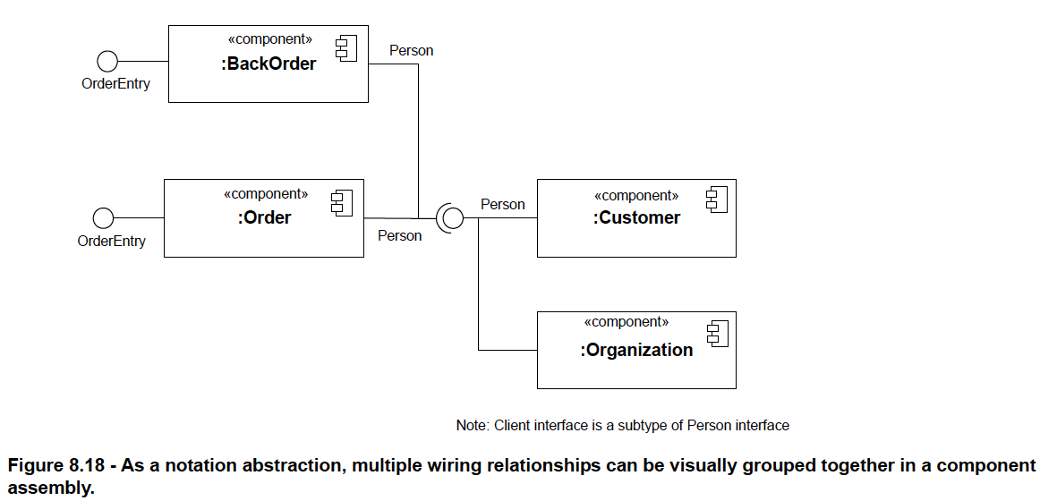

Slide 50
CASE STUDY
Development of an application collecting students’ opinions about courses
A student can
Read
Insert
Update
Make data permanent about the courses in its schedule
A professor can only see statistic elaboration of the data
The student application must be installed in pc client (sw1, sw2)
The manager application must be installed in pc client (in the manager’s office)
There is one or more servers with DataBase and components for courses management

Slide 51
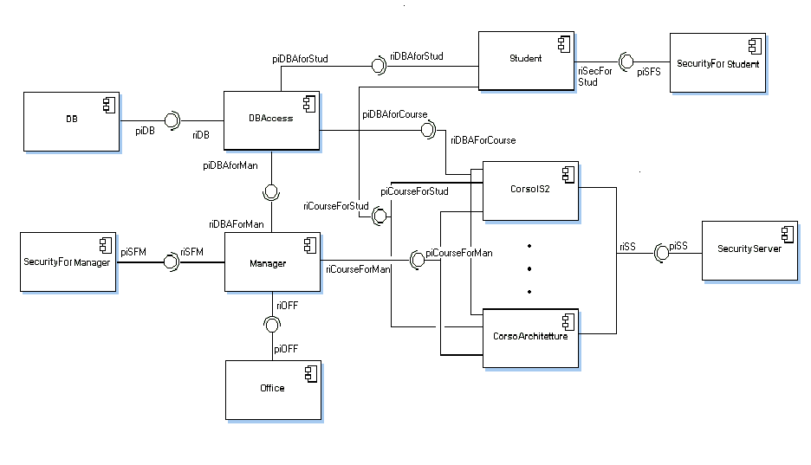
CASE STUDY

Slide 52
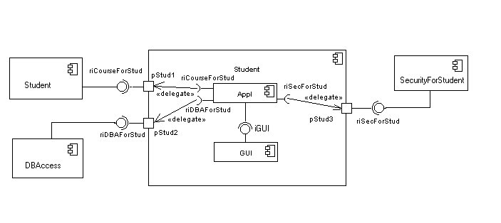
CASE STUDY

Slide 53
Component Diagram of an Insurance Policy Administration System

Slide 54
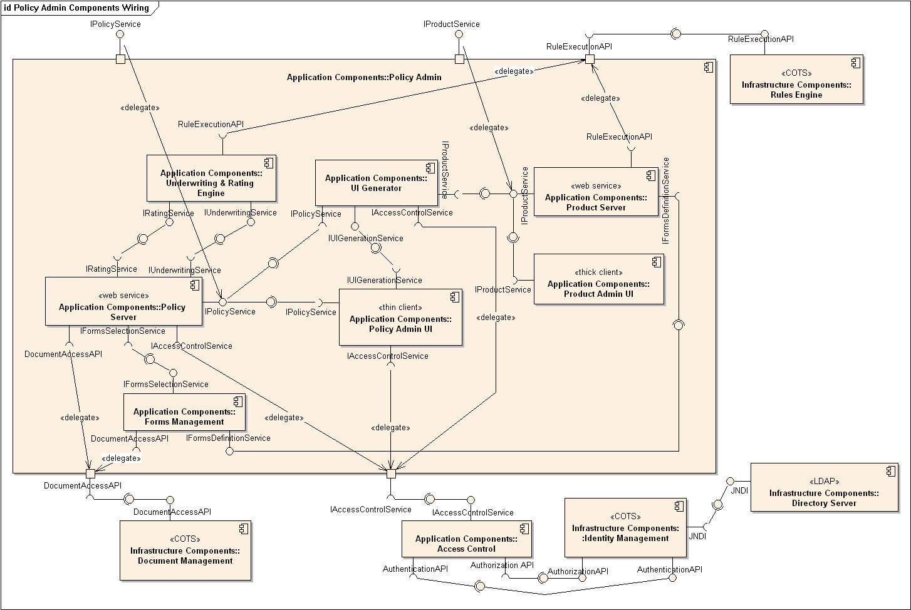

Slide 55
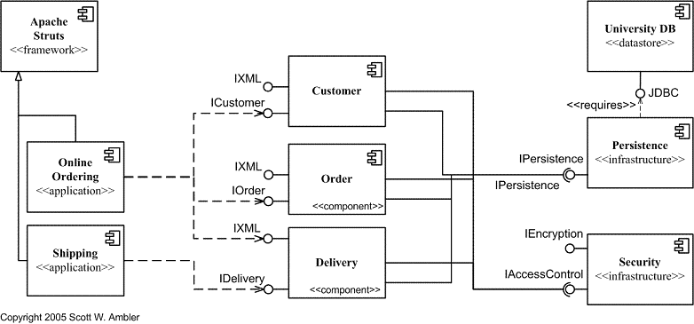
Another component diagram

